Slide 1
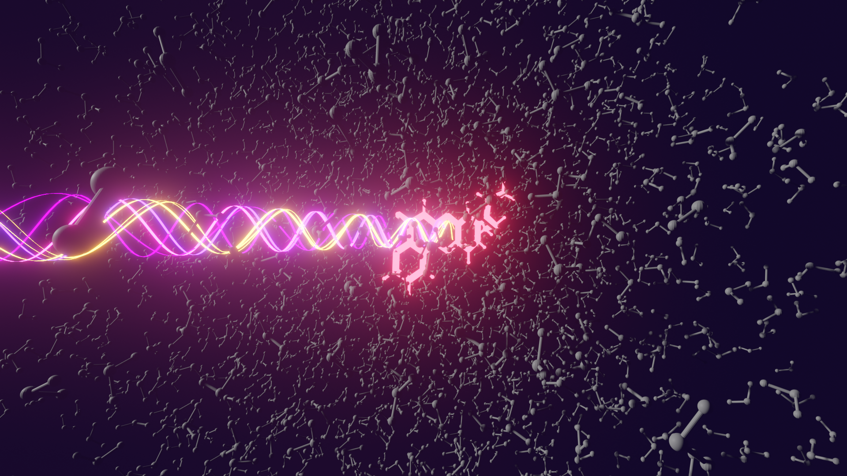

Excited States and Nonadiabatic Dynamics
Cybertraining Workshop 2022
QM/MM Simulation for Excited States
Davide Avagliano
University of Bologna
Buffalo, July 3-15 2022

Slide 2
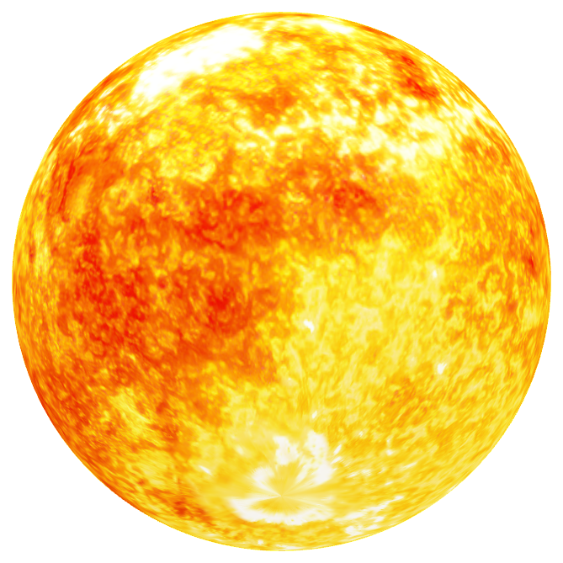
Photo-induced processes

Slide 3
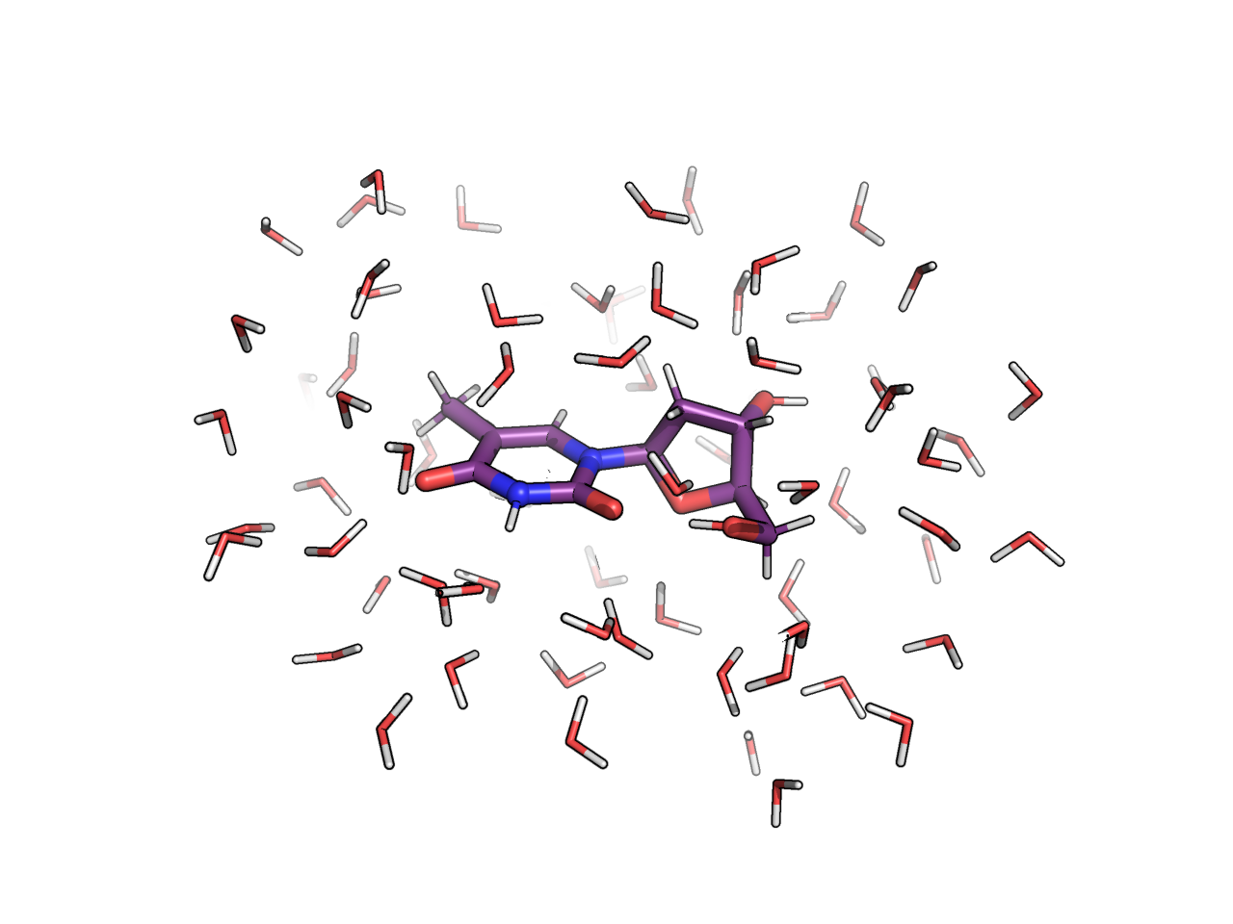
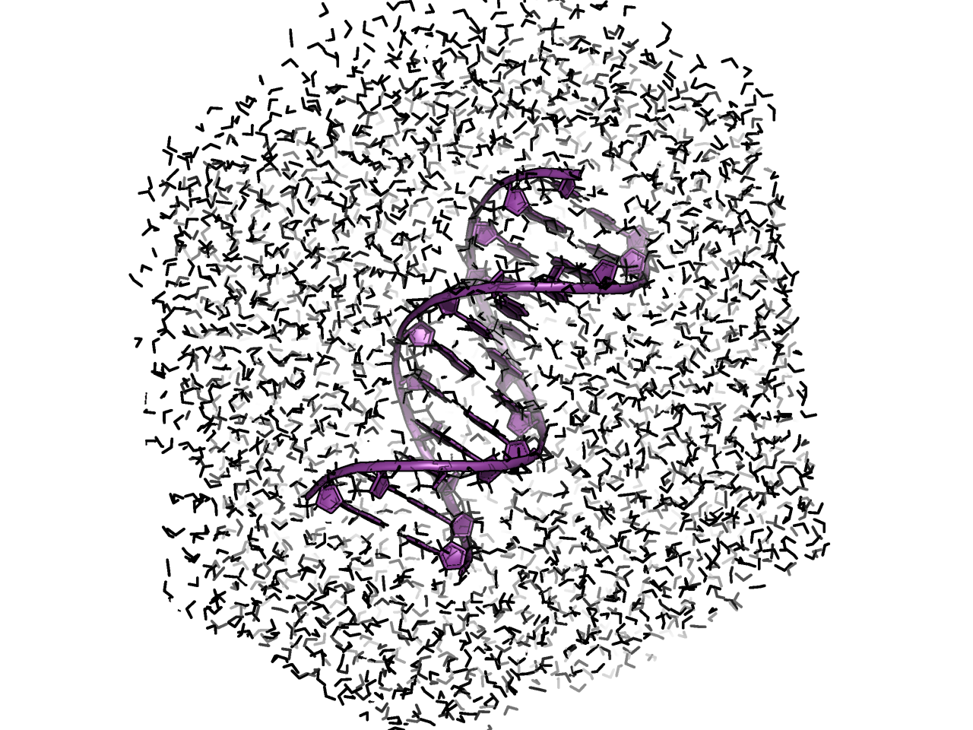
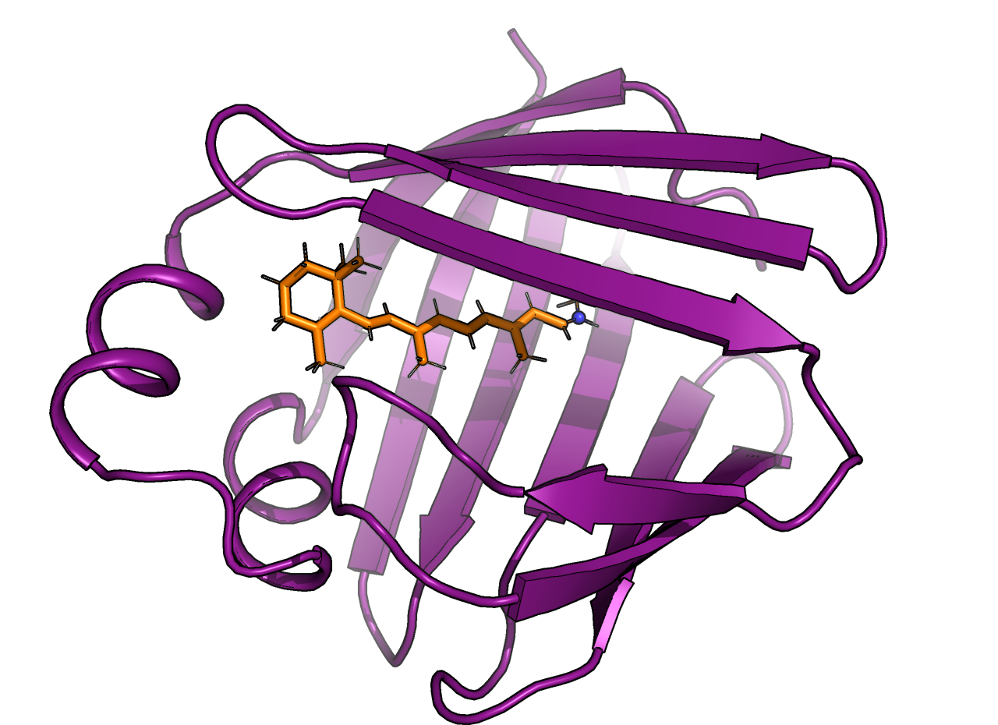
Photo-induced processes

Slide 4

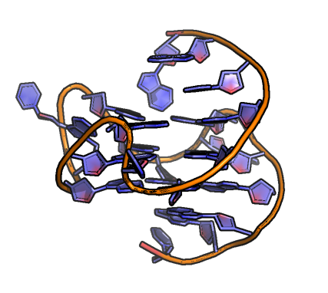
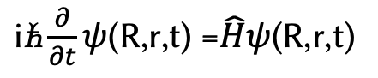
QM/MM
$\text{i}\text{ћ}\frac{∂}{∂t}ψ$(R,r,t) =$\hat{H}ψ$(R,r,t)
We know how to solve TDSE!
We know we cannot!
QM
do we always need high accuracy?
MM
for the full system?
we can introduce mindful approximations

Slide 5
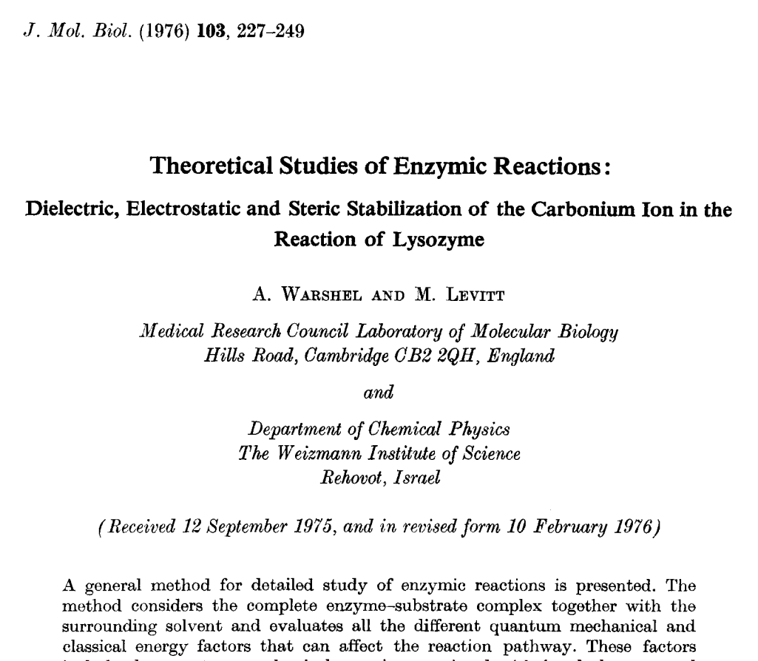
QM/MM
$\text{i}\text{ћ}\frac{∂}{∂t}ψ$(R,r,t) =$\hat{H}ψ$(R,r,t)
We know how to solve TDSE!
We know we cannot!
do we always need high accuracy?
for the full system?
we can introduce mindful approximations

Slide 6
QM/MM energy

Slide 7
QM/MM energy
Divide the system in region treated at different levels of theory
e.g. quantum mechanically (QM) and classically (MM)

Slide 8
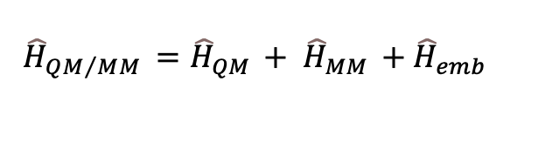
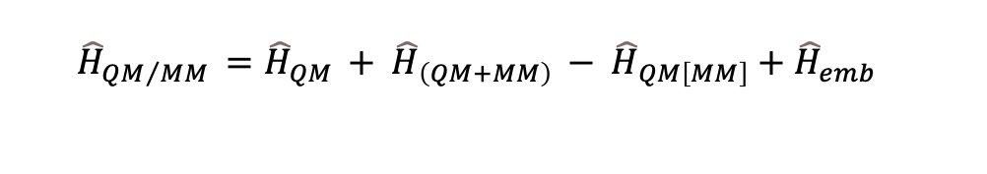
QM/MM energy
Divide the system in region treated at different levels of theory
e.g. quantum mechanically (QM) and classically (MM)
different schemes
additive scheme
$${\hat{H}}_{QM/MM }={\hat{H}}_{QM }+ {\hat{H}}_{MM }+{\hat{H}}_{emb }$$
subtractive scheme
$${\hat{H}}_{QM/MM }={\hat{H}}_{QM }+ {\hat{H}}_{\left(QM+MM\right) }− {\hat{H}}_{QM\left[MM\right]}+{\hat{H}}_{emb }$$

Slide 9
QM-MM coupling
electrostatic and dispersive interactions to be included
mechanical embedding
embedding interactions calculated at classical level
electrostatic embedding
MM point charges incorporated in the Hamiltonian
QM e density polarized by the charges
polarizable embedding
Each MM atom bears a charge and a polarizability
polarization induced by the electric field

Slide 10
QM energy
CASSCF
RASPT2
CASPT2 (SS,MS,XMS)
Multi-configurational
CC
ADC
TD-DFT
Single reference

Slide 11
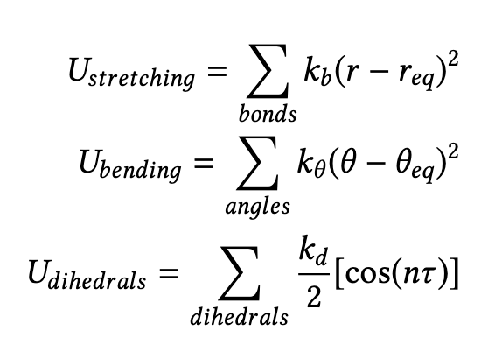
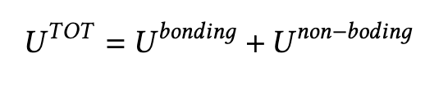
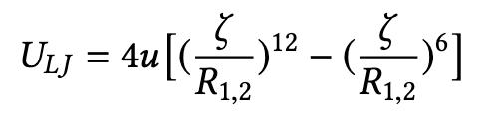
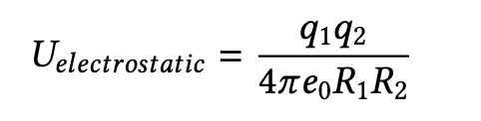
MM energy
Force Field
Bonding term
Non-bonding term

Slide 12
Boundary region
QM-MM boundary
System boundary

Slide 13
QM-MM boundary
QM-MM boundary
depends on the system
can involve covalent bonds
truncation of a covalent bond creates unrealistic and artificial system
enhanced over-polarization

Slide 14
QM-MM boundary
QM-MM boundary
covalent bonds
frozen orbital
boundary atom
link atom

Slide 15
Link-atom

Slide 16
Link-atom
QM₂
MM₂
QM₁
MM₁
MM₃
QM₃

Slide 17

Link-atom
QM₂
MM₂
QM₁
MM₁
MM₃
QM₃

Slide 18
Link-atom
QM₂
MM₂
QM₁
H
MM₁
MM₃
QM₃
link-atom approach

Slide 19
Link-atom
QM₂
MM₂
QM₁
H
MM₁
MM₃
QM₃
link-atom approach

Slide 20
Link-atom
QM₂
MM₂
QM₁
H
MM₁
MM₃
QM₃
link-atom approach
redistribution of the charge
MM blind to the H
distance QM₁-H constrained
gradient of H projected over QM₁ and MM₁

Slide 21
System boundary
System boundary

Slide 22
System boundary
Periodic boundary condition
finite-system approach - droplet
Ewald summation
generalization to more layers (ONIOM-like)

Slide 23
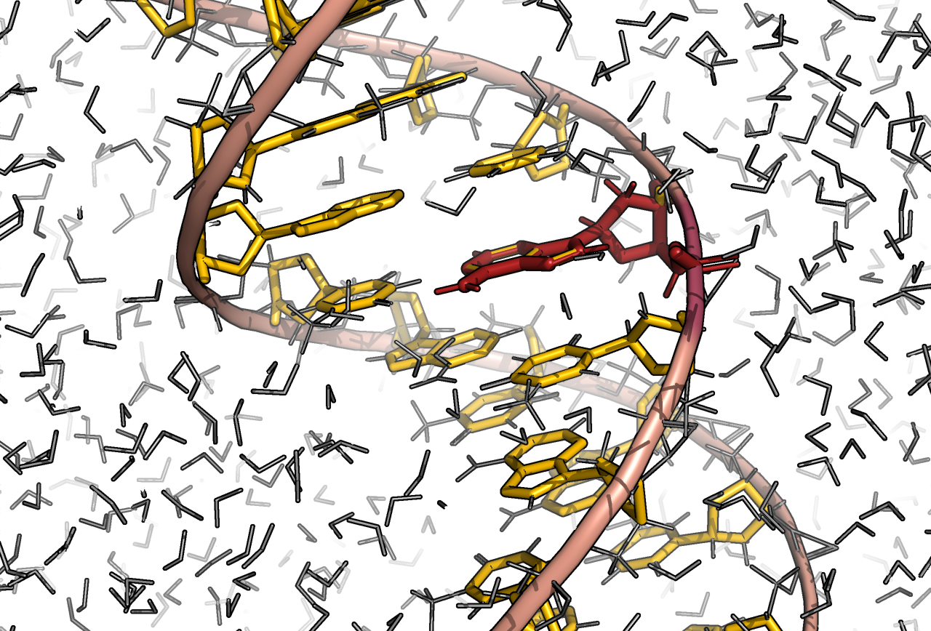
Excited states and QM/MM
solvent and environment alter excited state:
energies, properties, decay..
environment response slower than dynamics
solvent response is different for each electronic state
statistically meaningful representation
no FF parametrized ad hoc
small implementations required

Slide 24
Methodology and test cases
Configurational and phase spaces sampling
spectroscopic proprieetis
solvent response
static and dynamical approaches

Slide 25
Sampling
Solvated chromophore
Wigner distribution
probability to find molecule at position R
and with momentum p
- Pick random (R,p) pair from Wigner distribution
- Distort Req in normal mode direction
- Repeat for each normal mode

Slide 26
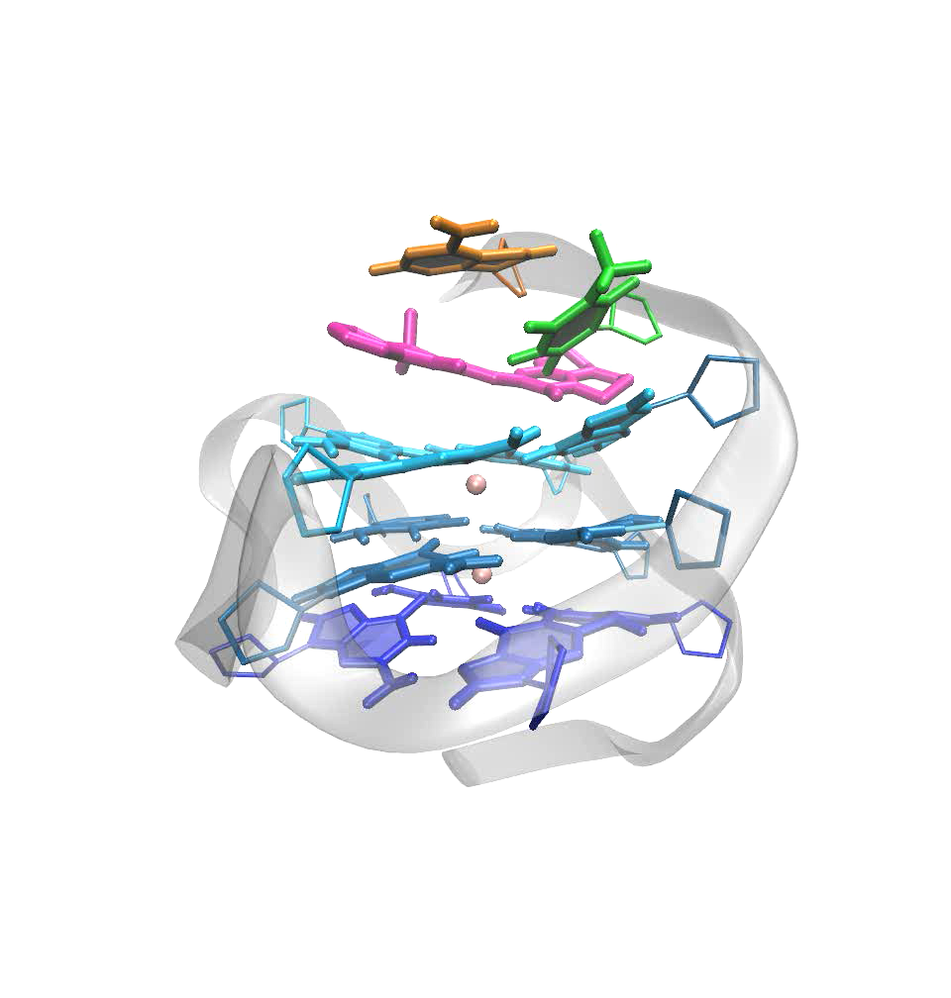
Sampling
more complex environment
Guanine
QMCH
QM region:
Thymine
Adenine
K⁺

Slide 27
Sampling
more complex environment
TD-DFT
Energy
QM/MM
Abs
MM
t

Slide 28
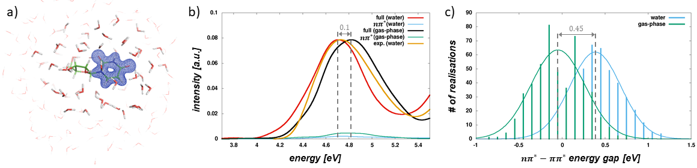
Spectroscopic properties
Solvated chromophore
Nat. Comm. 12, 7285 (2021)

Slide 29
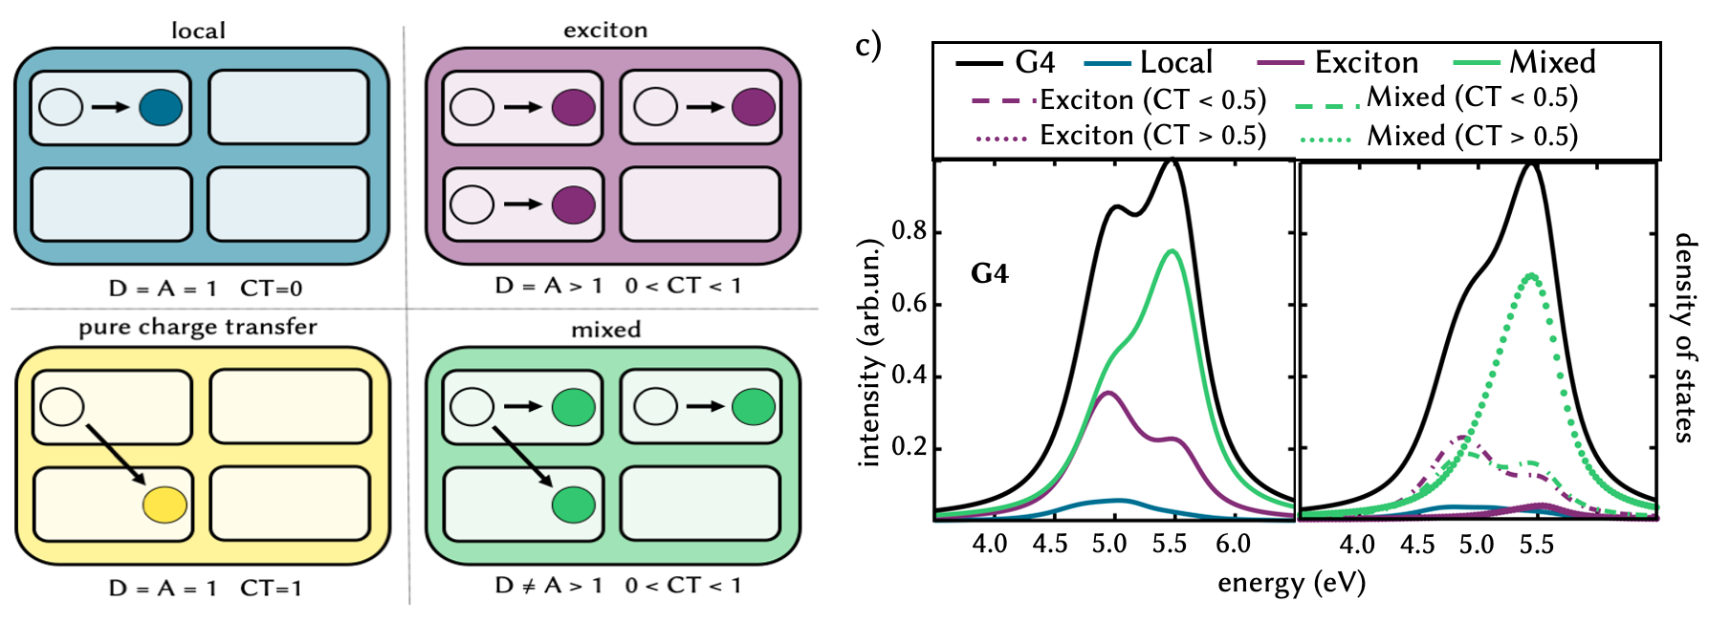
Spectroscopic properties
more complex environment
J.Phys.Chem.Lett.2020, 11, 10212−10218

Slide 30
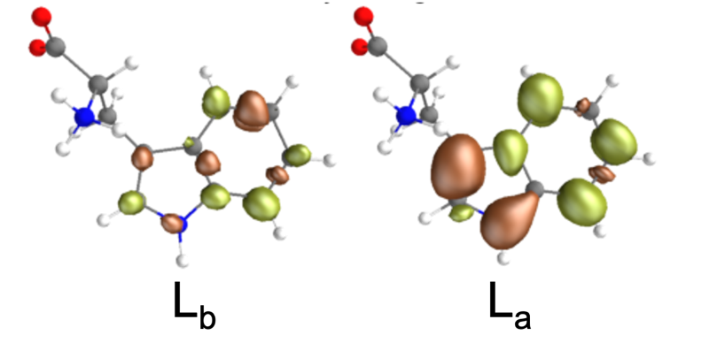
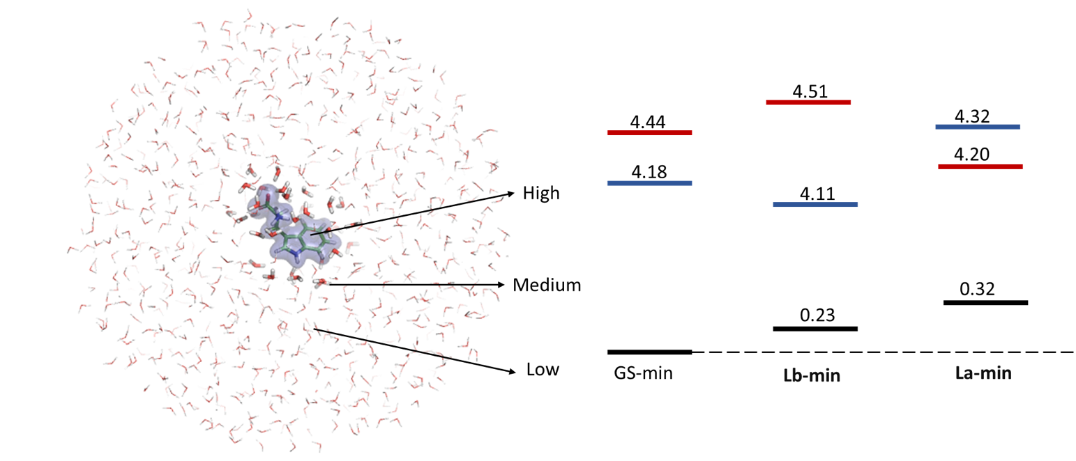
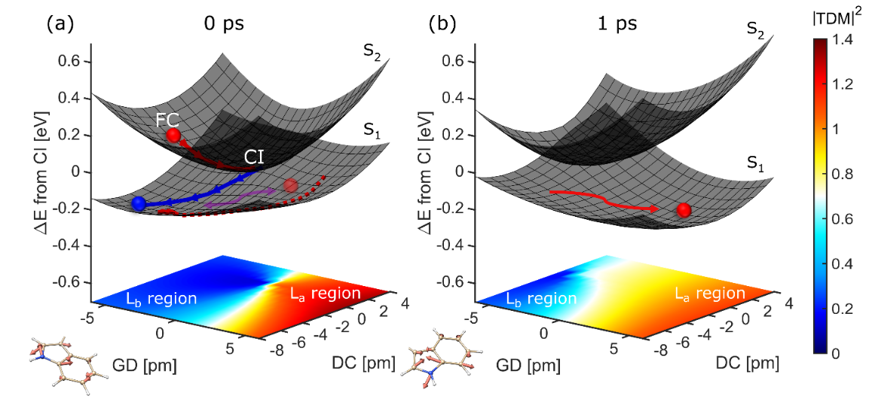
Solvent response
JACS, 2022 (just accepted)

Slide 31
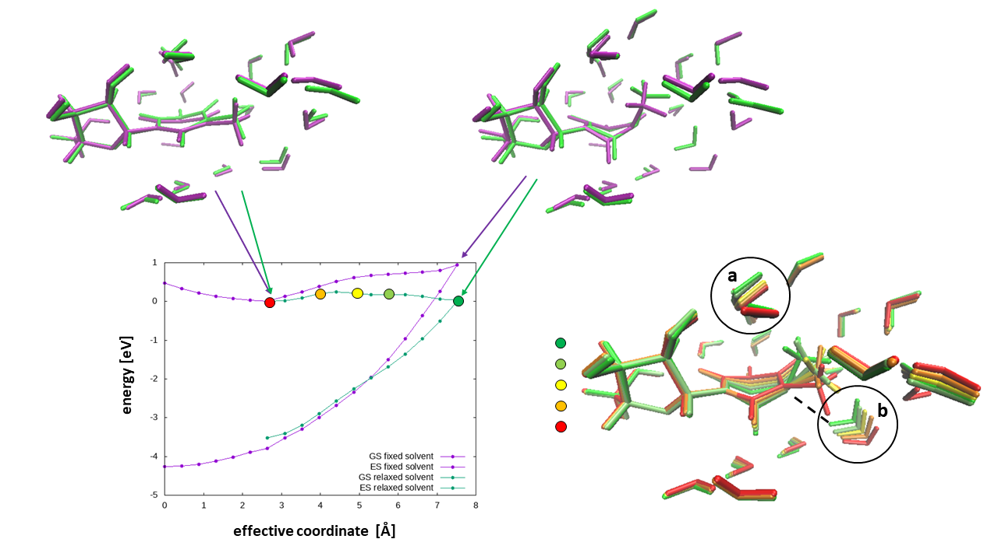
Statical and dynamical approaches
Optimization techniques
separate algorithm
single gradient approach
Nat. Comm. 12, 7285 (2021)

Slide 32
Statical and dynamical approaches
Nonadiabatic dynamics
Wavefunction propagation on parametrized potentials
microsolvation
mean effect
Trajectory-based methods
AIMS, FSSH
single initial condition solvation
J.Chem.Theory Comput., 2021,17,8,4639-4647

Slide 33
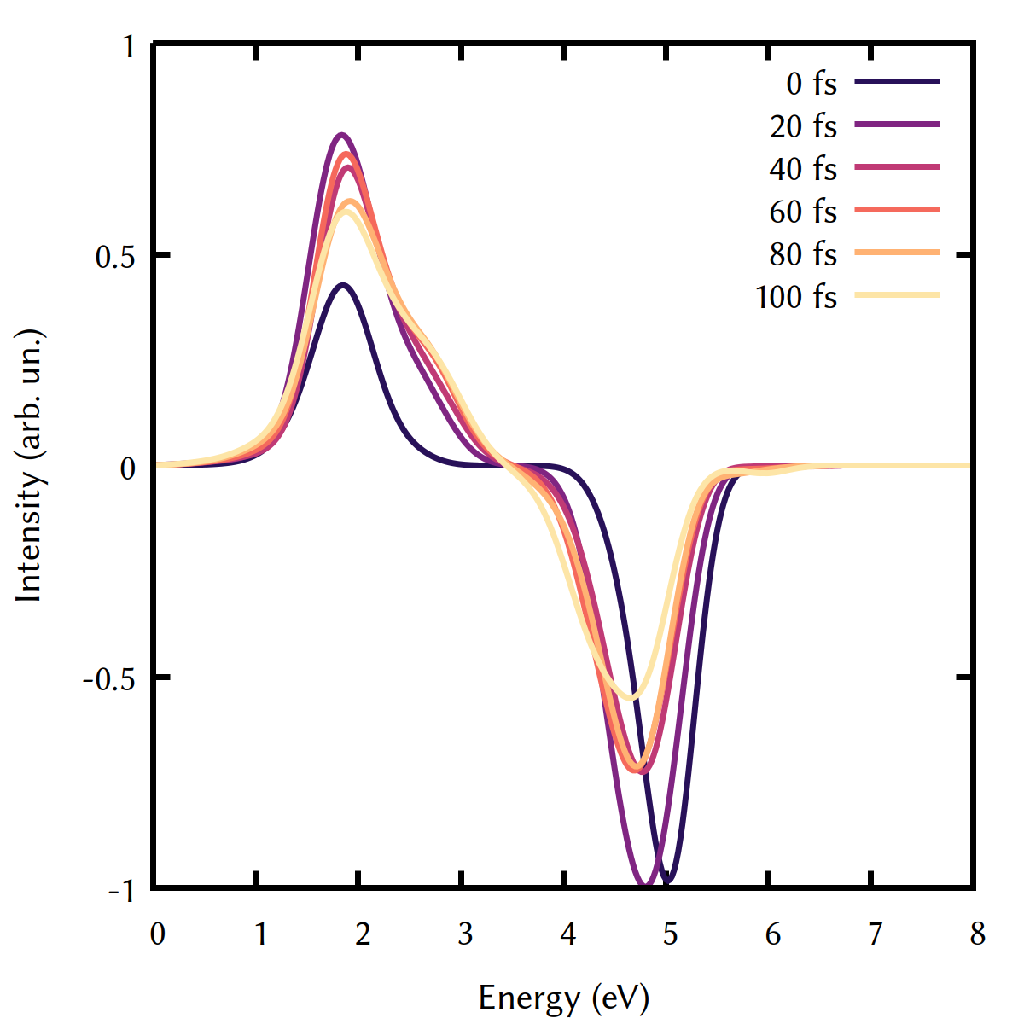
Dynamics and spectroscopy
J. Comp. Chem. (Just accepted)

Slide 34

COBRAMM
J. Mol. Model. 24, 271 (2018).
https://site.unibo.it/cobramm/en

Slide 35
COBRAMM
subtractive QM/MM scheme
photochemical MEP and CI search
transient absorption
nonadiabatic couplings
Fewest Switches Surface Hopping
many others...
J. Mol. Model. 24, 271 (2018).
https://site.unibo.it/cobramm/en

Slide 36
COBRAMM
Molcas/Gaussian
QM energy
QM gradient
Single point
Dynamics
Optimization/
MEP/CI search
QM
cobram.py
QM/MM
Gaussian
optimizer
AMBER
MM energy
MM gradient
MM
COBRAMM intenral routines
cobramm.log

Slide 37
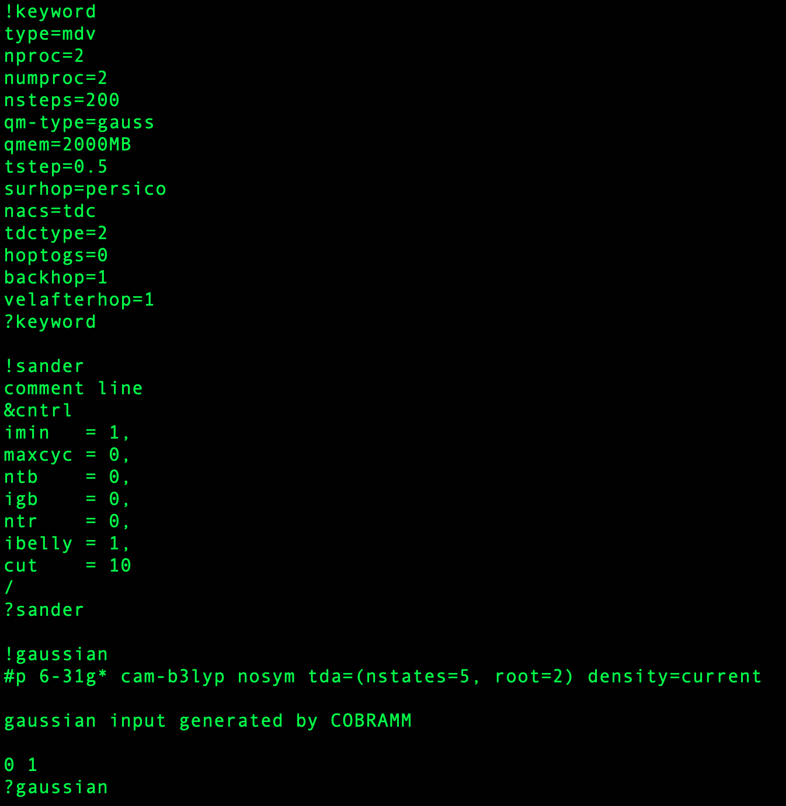
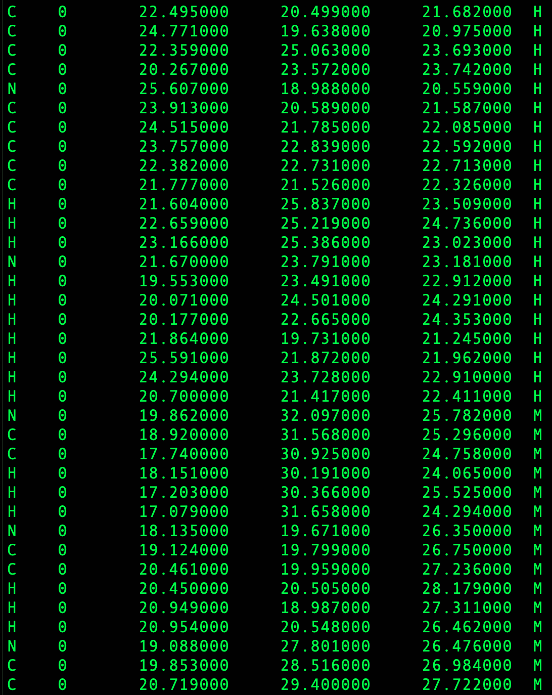
COBRAMM
cobram.command
real_layers.xyz
real.top
model-H.top

Slide 38
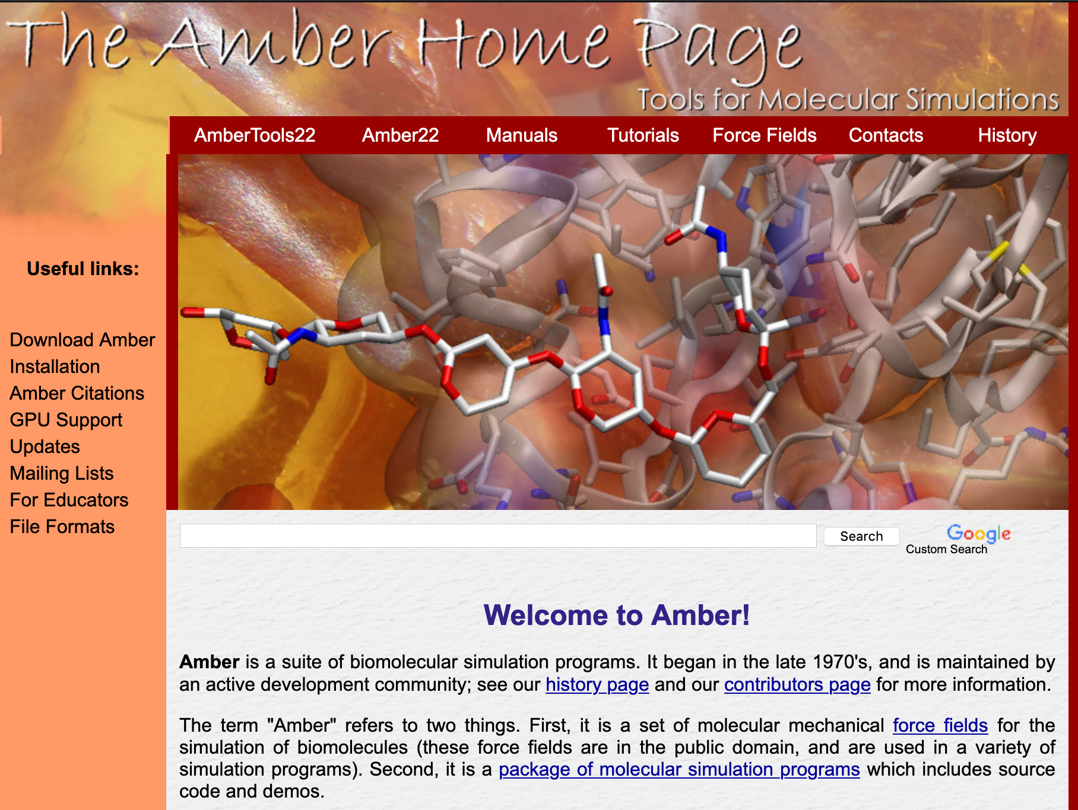
AMBER

Slide 39
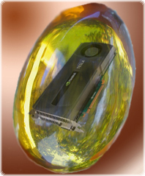
AMBER
PROGRAMS
tleap
antechamber
parmchk
sander
cpptraj
FILES
pdb/mol2/ prep
frcmod
top
crd
PROTOCOL
minimisation
heating
equilibration
production

Slide 40
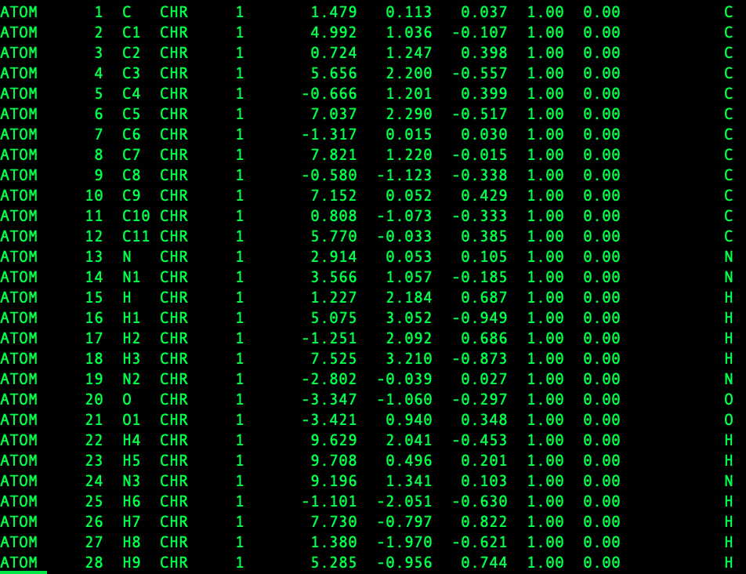
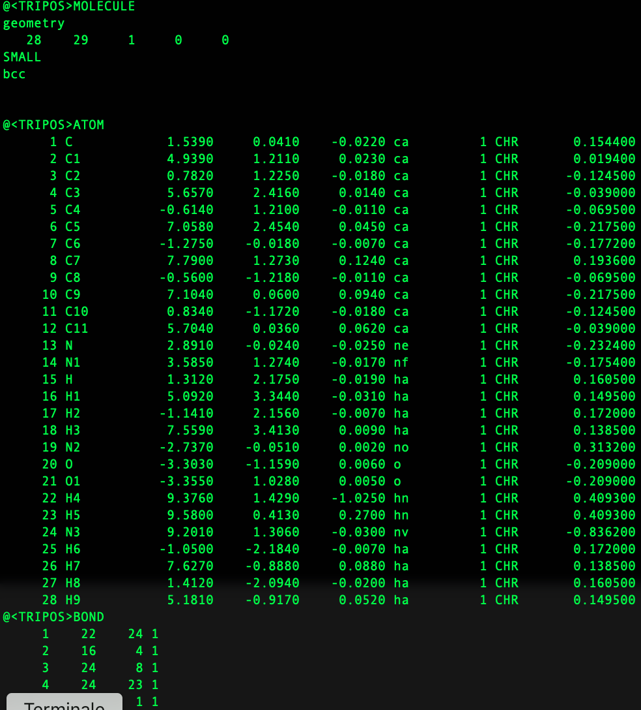
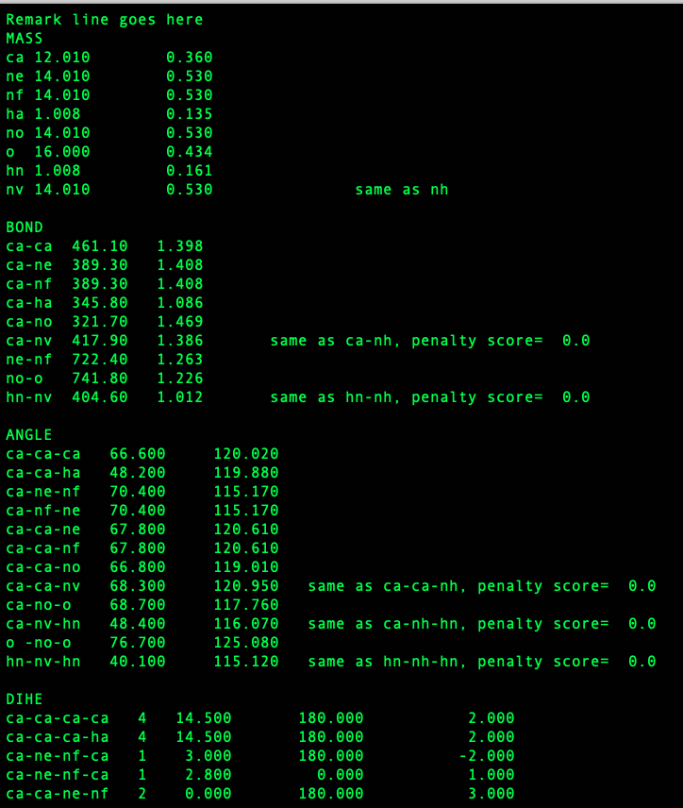
AMBER
pdb
mol2
frcmod

Slide 41
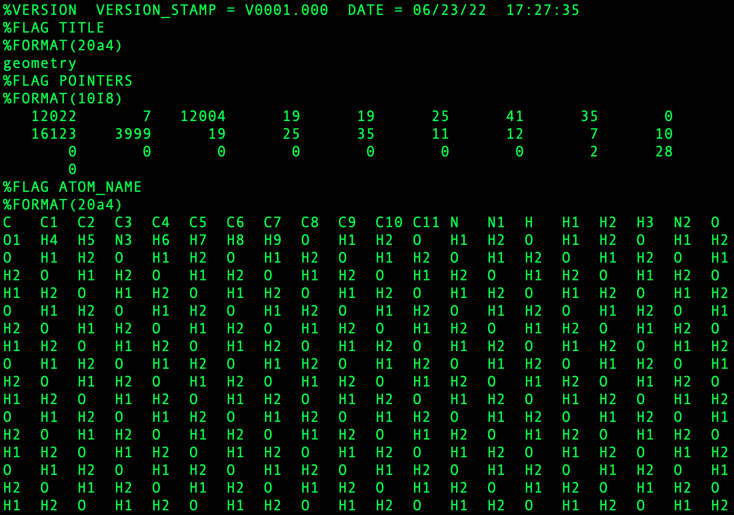
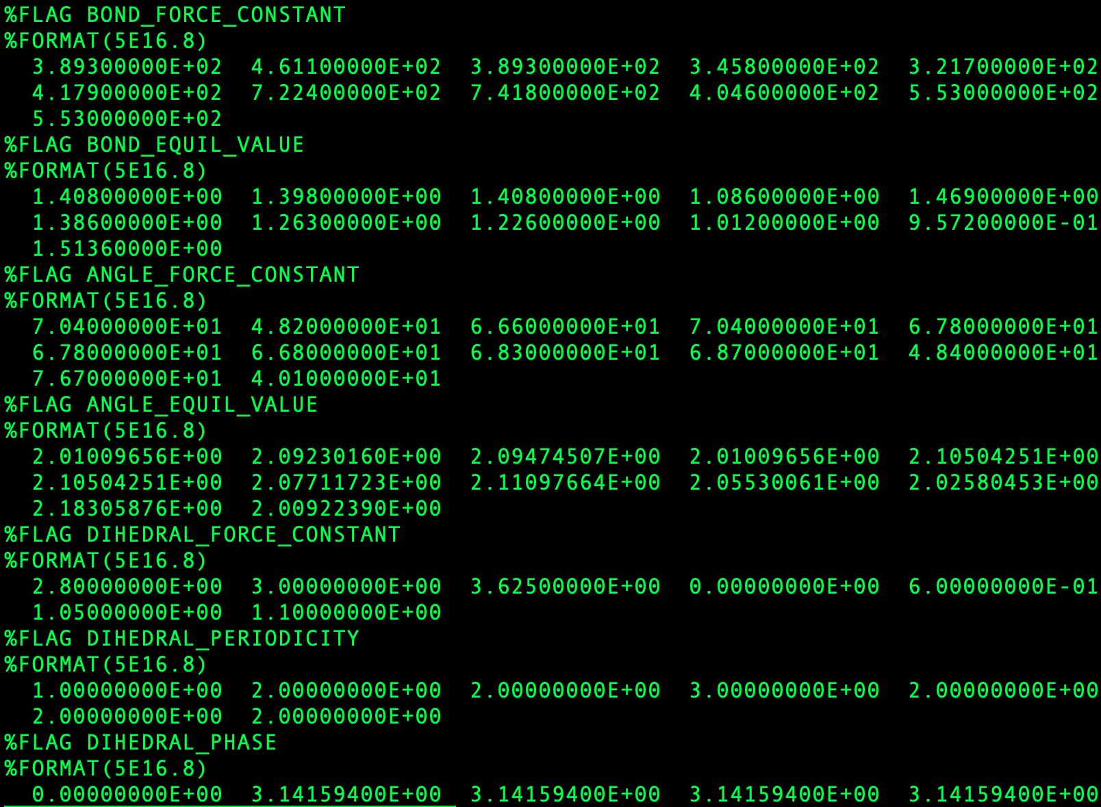
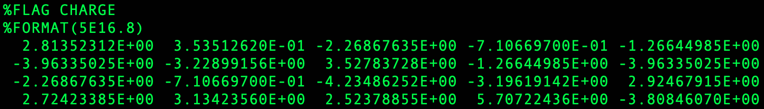
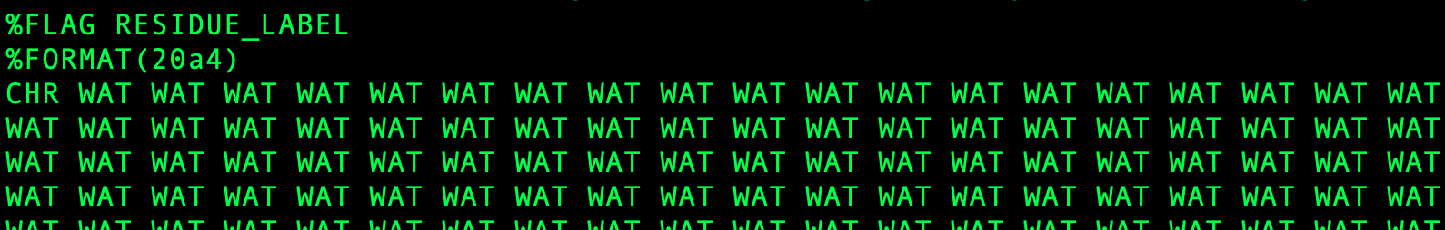
AMBER
topology file

Slide 42
Now we are ready for the Hands-on!!
Thank you for your attention!!

